Slide 1

Rockbuster Stealth LLC Digital Strategy Analysis
3/23/2024
Noah Manneville

Slide 2
Project OvervieW
Rockbuster Stealth LLC is historically a brick-and-mortar movie rental company facing competition from digital-only providers
A development strategy is needed to ensure RBS is competitive with major players like Netflix and Amazon
Data analysis from RBS’ library and sales is the key to finding the competitive edge

Slide 3
Key Questions
Who are our customers?
Where are our customers?
What is in our library?
How can we maximize profit?

Slide 4
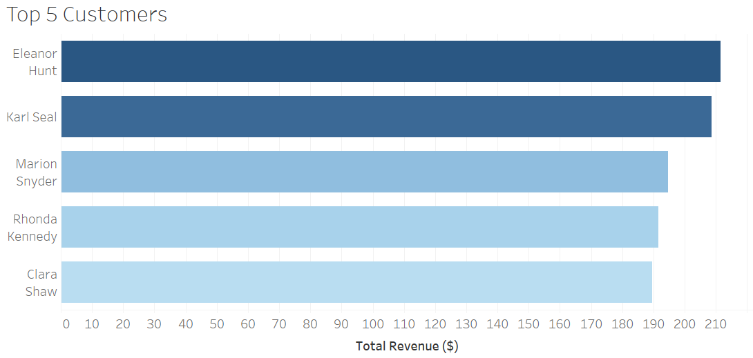
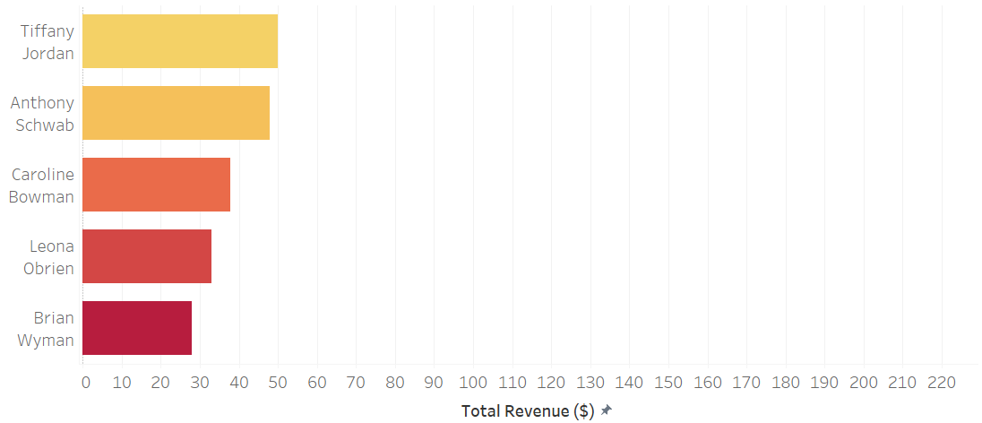
Customer Analysis
Who are our customers?
Average customer spends $102.36 per year
Top 5 customers spend nearly twice as much ($199.19)
Bottom 5 customers spend less than half ($39.29)

Slide 5
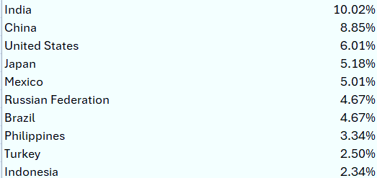
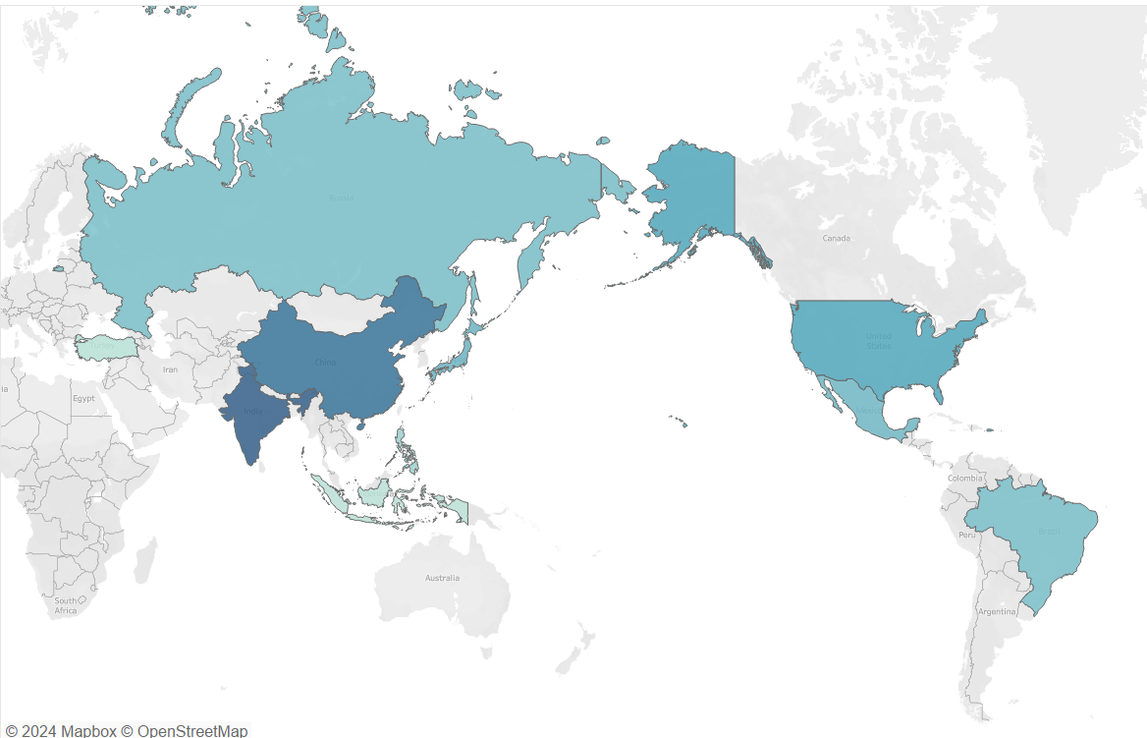
Customer Analysis
Where are our customers?
Ten countries are home to more than half of all customers
6 of 10 top countries are in Asia (incl. Russia)

Slide 6
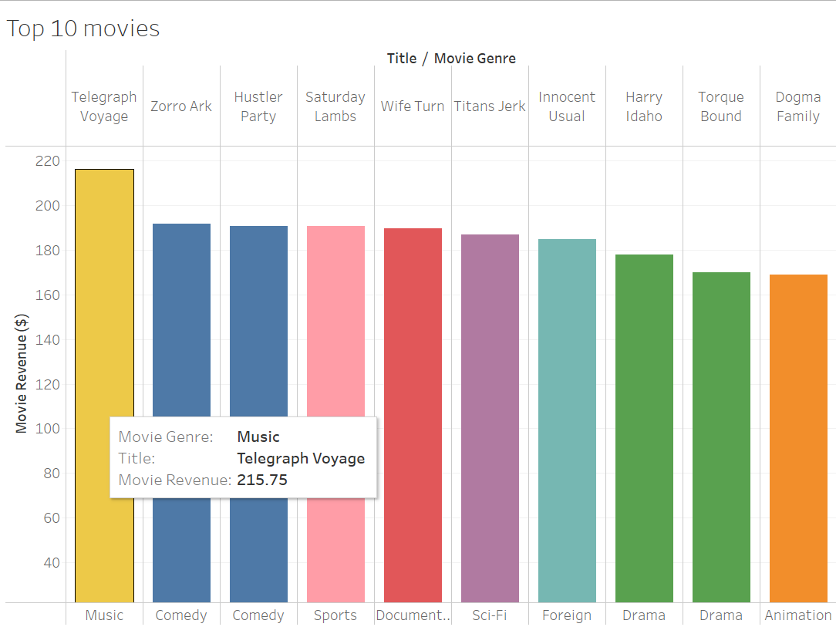
Rental Analysis
1000 unique movie titles
Nearly 600 customers
17 different genres
Top Movie - $ 215.75 revenue worldwide
Bottom 16 movies – less than $10 revenue each

Slide 7
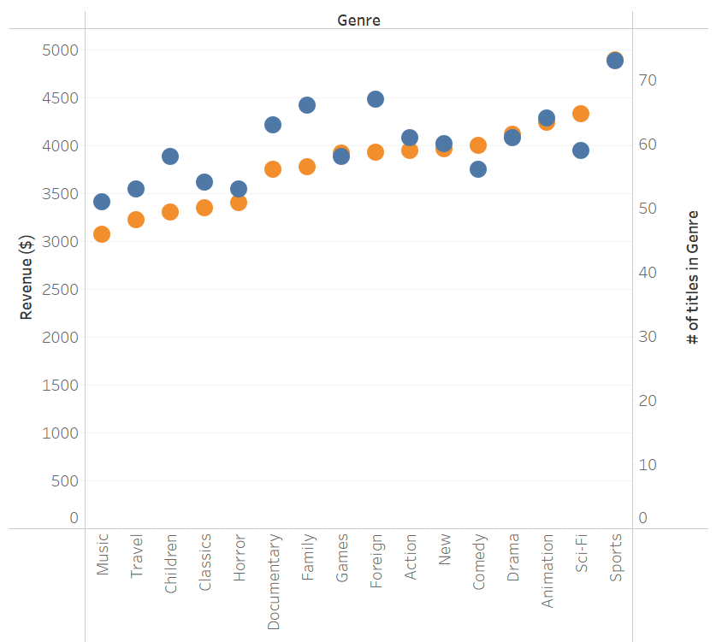
RENTAL Analysis
Most Rented Genre – Sports movies
1081 rentals, 73 unique titles
Least Rented Genre – Thriller
11 rentals, 1 title
Most Effective Genres
(Most rentals per individual title)
Sci-Fi – 16.92 rentals per movie
59 movies, 998 rentals
Animation – 16.64 rentals per movie
64 movies, 1065 rentals
Action – 16.61 rentals per movie
61 movies, 1013 rentals

Slide 8
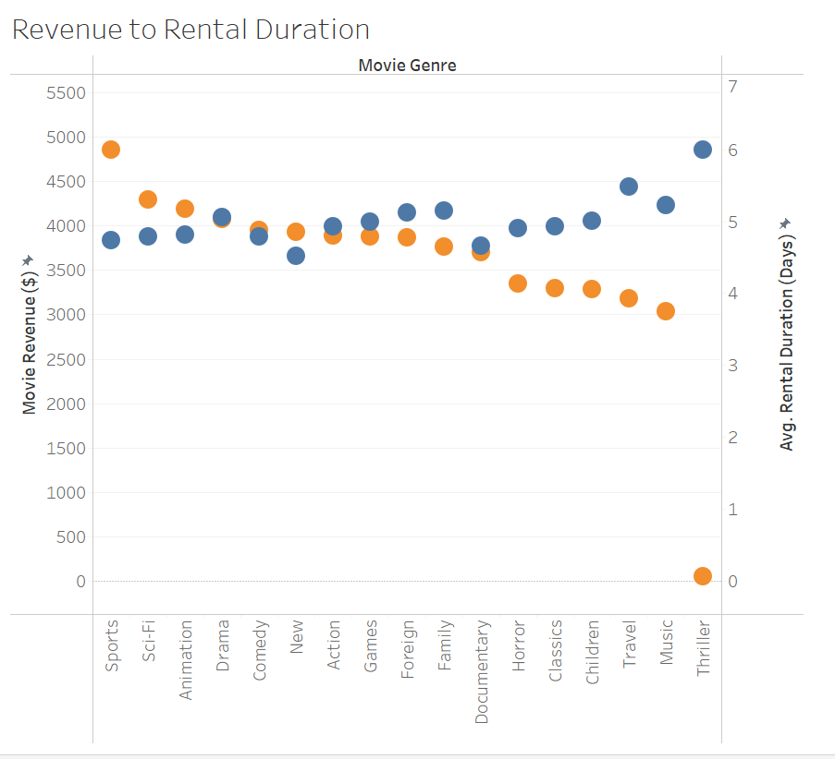
Rental Analysis
The average movie must be rented 7 times to be profitable
Average rental rate = $ 2.98
Average replacement cost = $20.05
113 movies were rented less than 7 times
Shorter rentals = more profit
The quicker a movie is returned, the sooner it can be rented again

Slide 9
Conclusions and Recommendations
Largest markets are in Asia
China, India, Japan, Indonesia, Philippines, Russia
Top customers are best customers
Top customers spend twice as much as the average and 4x as much as the bottom
Quick returns = more profit
Promote customers to return their rentals quickly so they can be rented again sooner
Movies that do not exceed replacement cost are not profitable
Consider replacing with movies from popular genres
Focus on high-volume genres
Sports movies are the most popular
Sci-Fi, Animation and Action provide the most bang for the buck

Slide 10

Thank you!
Visualizations can be found at:
https://public.tableau.com/app/profile/noah.manneville/viz/3_10-powerpointstoryboard/Story1
Please send questions, comments, and inquiries to
nmanneville@rockbusterstealth.com

